Slide 1
Episerver Workshop for .NET Developers

Slide 2
Speakers
Bruce Gordon
Located in Tallahassee, FL
Providing Technical Training since 1994
Specialize in Episerver Development, .NET, Angular, SharePoint, Microsoft SQL
Episerver Certified Developer ECD
Microsoft Certified Trainer MCT and Developer MCPD
Bruce.Gordon@Episerver.com

Slide 3
Schedule
Wifi Password: meeting2015
8:30 – Welcome Breakfast & Networking
9:00 – Introduction & Welcome
9:15 – What is the Episerver Platform
9:45 – Setting up the Developer Environment
11:00 – Break
11:15 – Defining content types
12:15 – Lunch
1:45 – Working with blocks
2:45 – Using dependency services
3:45 – Personalization
4:45 – Closing remarks
5:00 – Happy Hour at South Branch Grill

Slide 4
What is the Episerver Platform
Episerver Commerce – A unified digital commerce platform.
Episerver CMS - A market-leading CMS loved by editors and developers.
Episerver Campaign - Omnichannel marketing automation powered by AI.
Episerver Find - Enterprise search that can dynamically build landing pages.
Episerver Personalized Find - Search results based on real-time behavior.
Episerver Advance - AI-powered personalization for content.
Episerver Perform - Personalize products and recommendations using AI.
Episerver Reach - Personalize and trigger emails based on behavioral data.
Episerver Insight - Automatically capture and analyze visitor data.
Episerver Social - Micro-service that lets you store, manage, moderate and deliver ratings, reviews, comments and groups.

Slide 5

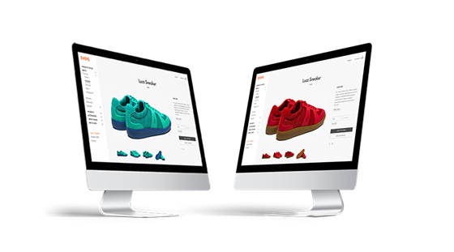

Episerver products and services you should know
Understanding Episerver CMS – Add-ons and other services
Episerver CMS: content management system.
Episerver Advance: personalized content recommendations.
Episerver Profile Store: our customer data platform (CDP) a marketer-managed system that creates a persistent, unified customer database that is accessible to other systems.
Episerver Insight: omnichannel visitor journey visualization.
Episerver Commerce: digital commerce integration platform.
Episerver Perform: personalized product recommendations.
Episerver Reach: personalized communication triggers.
Personalized Find: search results optimized for visitor.
Episerver Campaign: omnichannel marketing automation.
Individualized Content
Experience-Driven Commerce
Intelligent Campaigns = Campaign + Reach + Insight + Profile Store
Notes:
James Norwood: The Next Stage for Digital Experiences Is ‘Irresistible’
“Content is, as you would expect, at the heart of the matter. Rich contextual content is how you engage irresistibly. Although not a gap, it remains an incomplete area for many organizations.
Today, there’s emerging technology that can automatically apply meta data (tags) to digital content assets and then work out how to sequence and surface that content at scale.
Episerver has invested particularly heavily in this area, because while product recommendations are somewhat easy — for example, people who purchased this, also purchased that — content recommendations and more importantly content sequencing is really difficult. But if you can get it right, it delivers on the promise of irresistible digital experiences, where the ROI across the entire customer lifecycle is actually far higher.”
https://www.cmswire.com/digital-experience/james-norwood-the-next-stage-for-digital-experiences-is-irresistible/
Episerver Social
User-generated content has proved to be one of the most effective ways to market your products or services, to increase conversions rates, and to enhance employee productivity. Episerver Social offers extremely high performance and reliability with a fluent and easy-to-use API – without the bloat and complexity of other platforms.
https://www.episerver.com/solutions/our-customers/by-industry/ztable/

Slide 6
Episerver DX Platform
Developers must learn how to create a custom solution.
Business Users must learn how to manage and administer it.
CMS
Content Management System
Commerce
Digital Commerce System
Custom solution hosted in
DXC Service or elsewhere
Advance
Content Recommendations
Perform and Reach
Product Recommendations
Personalized Find
Search Recommendations
Cloud Services
Tracking, Profile Store, and Insight
Customer Data Platform and Profile Segments
Campaign
Email Service Provider
Social
Comments, Ratings, etc.
Notes:
Introduction to Episerver DXC Service

Slide 7
Understanding Episerver product names
Some people use just “DXC” to refer to DXC Service.
Digital Experience Cloud (DXC): an umbrella term for all Episerver products and services, even when not hosted in the “cloud”.
DXC License: our products charged per server or server instance.
DXC Service: our products charged per consumption rates. All underlying services used by DXC Service are included. Page views and SKUs in excess of the agreed amount will be billed at the contracted overage rate. Prepaid excess consumption is discounted.
DXC License | Server (tied to MAC address) | Instance (“phones home” to check license)
Perpetual | On-premise | In cloud (AWS, Azure, and so on)
Term-Limited | On-premise | In cloud (AWS, Azure, and so on)
Notes:
Copyright © 2019 Episerver. All rights reserved.
Page 7
Introduction to Episerver DXC Service

Slide 8
Workshop Topics Outline
Setting up the Developer Environment
Defining Content Types
Working with Blocks
Using Dependency Services
Personalization
Workshop is mostly demos (not much PowerPoint). Feel free to work along on your own laptop with the provided demos/exercise manual.
Solution code can be downloaded from: https://github.com/bruceEgordon/Epidemosite

Slide 9
Setting up the Developer Environment
Install Episerver Visual Studio Extension
Project templates for Empty site and Alloy sample site
Item templates for common Episerver items
Configure Episerver NuGet package source
Episerver maintains https://nuget.episerver.com/feed/packages.svc
License not required when running under IIS Express
Defaults to local SQL Server
Database files located in project folder under App_Data
Only consumes workstation resources when the site is running

Slide 10
Demo Setting up Developer Environment

Slide 11
Defining Content Types
There are two minimum requirements to define a type of content in Episerver:
Apply [ContentType] attribute and "implement" IContent
There are four main types of content built-in to Episerver CMS:
Page: an instance of a class that derives directly or indirectly from PageData
Folder: an instance of ContentFolder
Media: an instance of a class that derives directly or indirectly from MediaData or its subclasses ImageData and VideoData
Block: an instance of a class that derives directly or indirectly from BlockData
Episerver Forms use FormContainerBase which inherits from BlockData so forms are treated as a special type of block

Slide 12
Demo Defining Content Types

Slide 13
Working with Blocks
Blocks are reusable widgets of functionality (shared asset Blocks)
Block types can be defined as a property typed (not shared)
Episerver Block Type template creates class that inherits BlockData
Blocks can have a controller or by “controllerless”
Controllerless blocks are more efficient

Slide 14
Demo Working with Blocks

Slide 15
Using Dependency Services
Out-of-the-box Episerver uses StructureMap
Services can be located using ServiceLocator.Current.GetInstance:
Constructor parameter dependency injection require registration of a class that implements IDependencyResolver:
Default services can be replaced with Intercept:

Slide 16
Demo Dependency Services

Slide 17
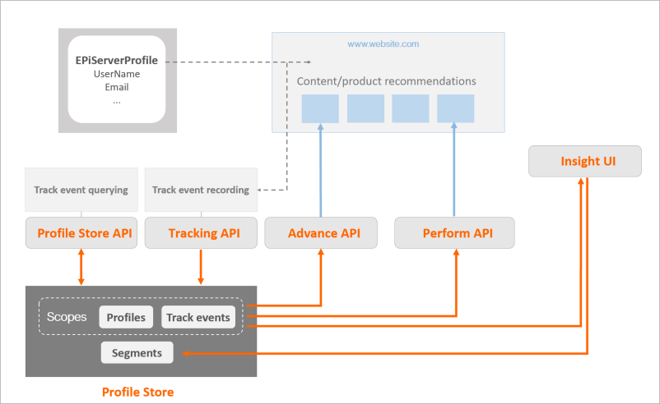
Personalization
Basic out-of-the-box CMS has Personalization Groups
With cloud subscription you get a Profile Store
Advance and Perform use AI to provide more automated personalization (outside the scope of this workshop)

Slide 18
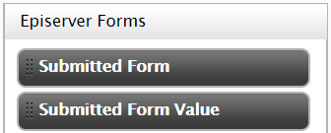
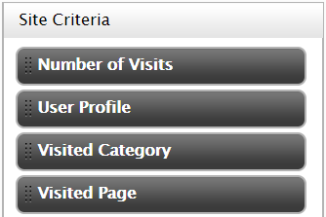
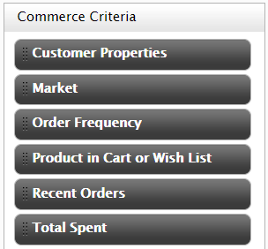
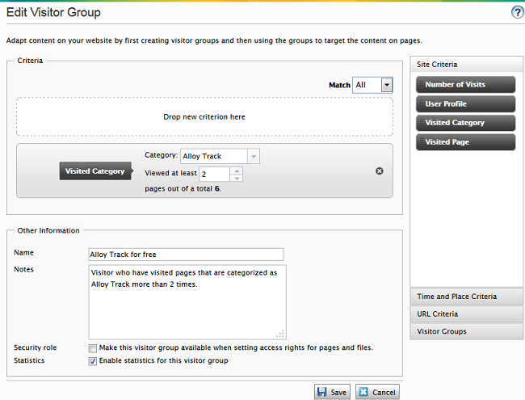

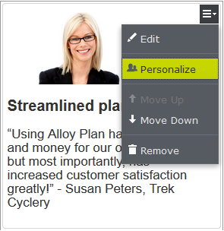
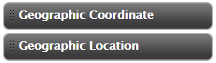

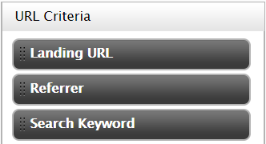

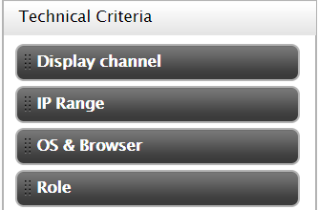
Personalizing content with visitor groups
Personalizing content – Visitor Groups
1: Define visitor groups
with various criteria.
Block
2: Use the visitor groups
in pages and blocks.
Page
There are 11 built-in criteria…
…but the two Geographic ones are hidden until you configure a geolocation provider.
Install EPiServer.VisitorGroupsCriteriaPack for ten more including Technical Criteria, install EPiServer.Forms.Samples for two more, and developers can create custom criteria.
Notes:
Personalization can be done for partial pages and shared asset blocks in a content area, and for any content in a rich-text editor (property of type XHTML string).
Visitor Group Criteria can be defined with logical rules or with fuzzy scoring.
You can develop your own criteria and plug it into the existing criteria collection.
You can preview any page or block as any visitor group by using the view toggle setting.
Built-in reports on which groups visit your site: Visitor Groups Statistics gadget.
Visitor groups can be used as Security roles when setting access rights for pages and media assets.
Enabling a Geolocation provider
As of version 11.4.0 of the Episerver CMS Visual Studio Extensions, new CMS projects will no longer be created with a Geolocation provider configured.
https://world.episerver.com/documentation/developer-guides/CMS/personalization/Configuring-personalization/

Slide 19
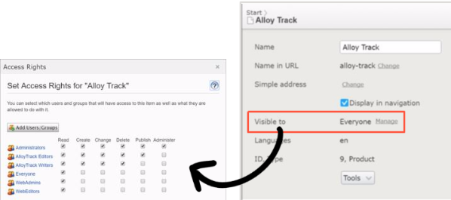
Personalizing pages and media assets
Personalizing content – Visitor Groups
Like blocks, pages and media assets can be personalized. While editing a page, click Visible to, remove Read access right for Everyone and add a Visitor Group and give it Read access rights.

Slide 20
Demo Personalization with Visitor Groups

Slide 21
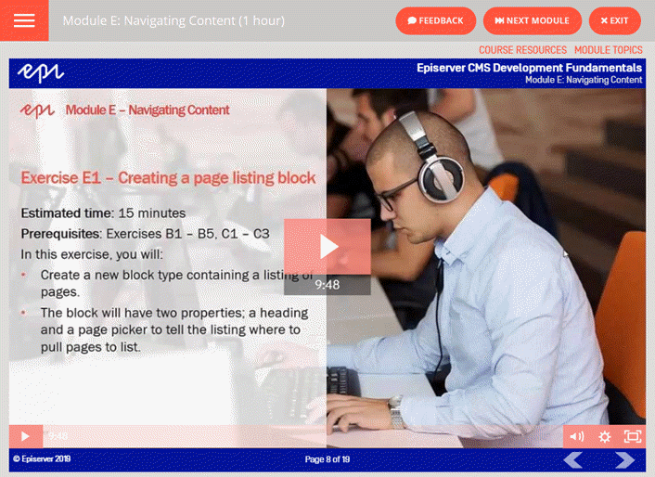
Episerver Developer Training
https://education.episerver.com/collections/developers

